Slide 1

SkillSight
Detecting Explicit vs. Implied Skills in Text (0.5 / 1)
Presented by: Yonatan Elman, Michael Kovalchuk, Roni Fadlon

Slide 2



Project Review
Motivation Extract CS/Hi-Tech skills from resumes with Explicit/Implicit labels (from a predefined Global Skill Vector).
Vector → Sparse list: only relevant skills are stored, labeled 1.0 / 0.5.
We added skill aliases (for explicit mentions).
We defined a fixed global vector of 110 CS-related skills.
We switched from 0/1/2 to 1.0/0.5, where 0 means the skill is not present / not predicted.
Novelty The model extracts implicit skills from context, not only explicit keywords.

Slide 3

Literature Review
Paper (Year) | Task | Methods | Data | Results | Relation to our project
Implicit Skills Extraction Using Document Embedding (2020)
Skill ext. + CV↔JD match; add implicit
Doc2Vec similar JDs + transfer
1.1M JDs
F1=0.83; MRR=0.88
implicit via similar JDs; ours per-text evidence
A Survey on Skill Identification
From Online Job Ads (2021)
108 papers
background only (no explicit/implicit evidence)
Survey of skill ID from job ads
Taxonomy (bases/methods/granularity)
challenges + trends
SKILLSPAN
Hard and Soft Skill Extraction (2022)
391 JPs; 14.5K sentences
explicit spans; ours evidence (incl. implicit)
Span-level skill extraction + dataset
BERT + domain-adaptive; single vs multi
domain-adapted better; single>multi

Slide 4


Dataset
Synthetic JSONL dataset: job_description (4–6 sentences) + skills (3–6 skills) from a predefined GLOBAL_SKILL_VECTOR.
Labels per skill: 1.0 = Explicit, 0.5 = Implicit.
Generated with LLM (gpt-4o mini) using a structured prompt
aliases for Explicit skill.
Post-generation: automatic validation & repair to prevent leaks/missing explicit mentions.
473 synthetic samples
110 skills in the Global Skill Vector

Slide 5
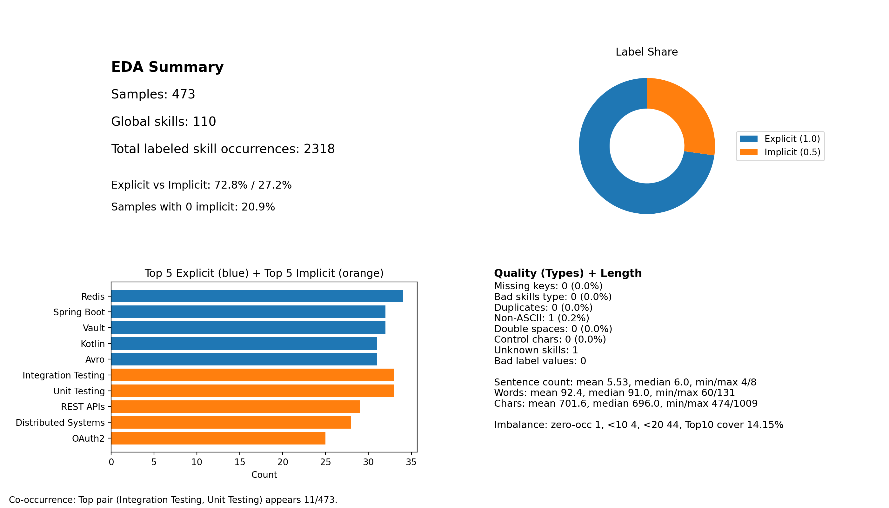
EDA

Slide 6
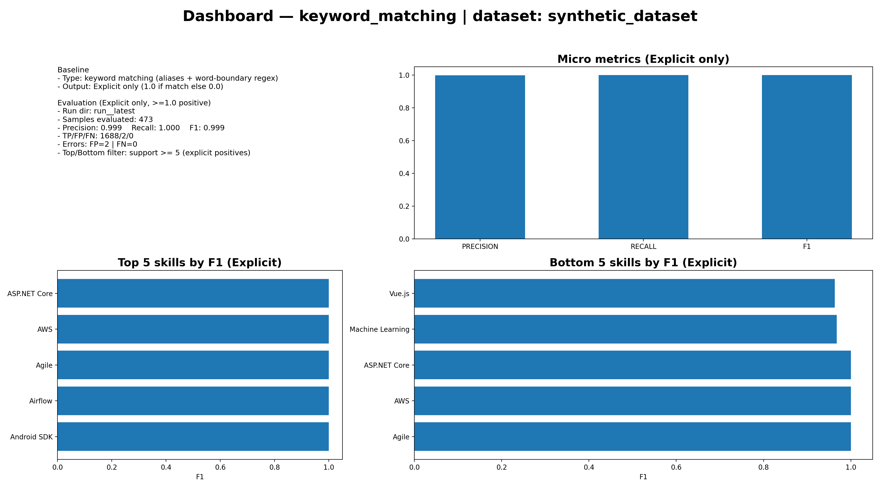
Baseline 1- keyword matching
Type: keyword matching (aliases + word-boundary regex)
Output: Explicit only (1.0 if match else 0.0)
N=473 | Micro F1=0.999 | TP/FP/FN=1688/2/0
Errors: FP=2, FN=0
High explicit scores are expected because labels rely on alias presence.
FP #1 — Machine Learning (gt=0.5 → pred=1.0)
Trigger: “machine learning initiatives”
Reason: Explicit-only baseline
FP #2 — Vue.js (gt=0.5 → pred=1.0)
Trigger: “Vue.a”
Reason: spurious match

Slide 7
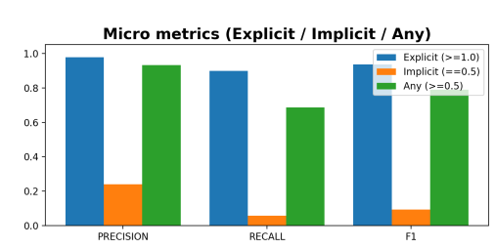
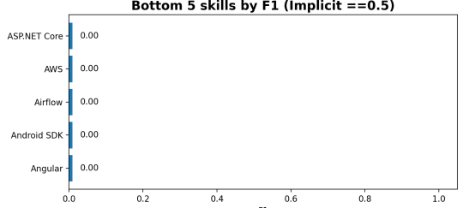
Baseline 2- zero shot
Type: Zero-shot classification (LLM + prompt) over GLOBAL_SKILL_VECTOR
Output: predicts 0.5 (Implicit) / 1.0 (Explicit)
N=473
Micro F1:
Implicit (==0.5): 0.094 (P=0.240, R=0.059)
Key takeaway: Strong on Explicit, very weak on Implicit (low recall).
FN #1 — Load Balancing (gt=0.5 → pred=0)
Trigger: “peak traffic”, “rate limiting”
Reason: Implicit-only cue (no explicit mention)
FP #1 — Tailwind CSS (gt=1.0 → pred=0.5)
Trigger: “using Tailwind …”
Reason: Explicit mention, but model downgraded to implicit (uncertainty/noisy phrasing)

Slide 8
Plan
Step | When | What we will do (Scope) | Expected outcome
1 | Week 10 | Generate 1,500–2,000 synthetic samples; strengthen implicit cues; reduce label leakage; rebalance 0/0.5/1 | Larger dataset (1,500–2,000) + cleaner implicit ground truth
2 | Week 10 | Re-run EDA + baselines on updated data | Updated metrics + identified failure modes
3 | Week 10 | Stronger baseline inference (zero-shot with stronger LLM) | Better reference baseline for implicit
4 | Week 11 | Build and fine-tune a classifier for 0/0.5/1 using BERT/RoBERTa | Build a dedicated model for explicit vs implicit labeling
5 | Week 11 | Error analysis iteration (top errors + skill-specific fixes) | Targeted improvements + final evaluation
6 | Before deadline | Prepare final presentation + report | Final submission package

